Slide 1
Contrast in complex images
By Xuhong Cao

Slide 2
Introduction
What is contrast?
How to define it?

Slide 3
Introduction
What is contrast?
Variance
Spatial frequency. (luminance change)
Human sensory systems (vision, audition, olfaction, taste, touch, temperature) :organized to respond strongly to temporal and spatial changes in the physical power of the stimulus.
Notes:
The variety of popular statistics for luminance contrast mostly reflects the fact that the adaptation state of the eye is affected differently by different kinds of stimulus pattern.

Slide 4
Introduction
Definition of contrast in simple patterns
Weber Contrast
Used for patterns: small, sharp-edged graphic objects like symbols and text characters on larger uniform backgrounds.
background is lighter than the symbol CW: negative(0 to – 1); background is darker than the symbol CW: positive(0 to ~~).

Slide 5
Introduction
Michelson Contrast
For simple periodic patterns (e.g., textures) there is no large area of uniform luminance that dominates the user's brightness adaptation. There is no clear choice for the denominator of the above statistics .
Equation:

Slide 6
Definition of Contrast in images

Slide 7
One common way(root mean square contrast)
With this definition, images of different human faces have the same contrast if their rms contrast is equal. 9 The rms contrast does not depend on spatial frequency content of the image or the spatial distribution of contrast in the image.
Xi: It’s a gray value of some point

Slide 8
Local Contrast
The local nature of contrast changes across an image and spatial frequency content are related and should be considered together.
I: Background luminance
Global contrast v.s Local contrast

Slide 9
Global Contrast v.s Local Contrast

Slide 10
Band-Limited Contrast
This definition was applied globally to the whole image as well as to one-quarter or one-sixteenth subimages in nonoverlapping windows.
A(u,v) : Amplitude of the Fourier transform of the image
DC: the zero frequency component.

Slide 11
New definition: Local band-limited contrast
Since human contrast sensitivity is highly dependent on spatial frequency, especially at threshold, contrast for each spatial frequency band is calculated separately.
f (x, y): the original image
g (x, y): inverse Fourier transform of the band-pass filter transform G(r)
l (x, y): luminance of the point

Slide 12
New definition: Local band-limited contrast
Left column: Bandpass amplitude image
Right column: Local band-limited contrast image
Top: 16 cycles per picture
Down: 32 cycles per picture

Slide 13
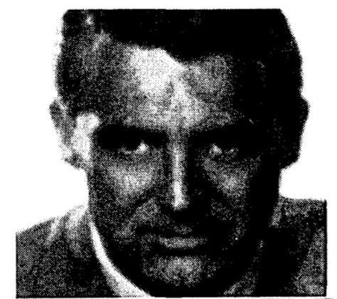
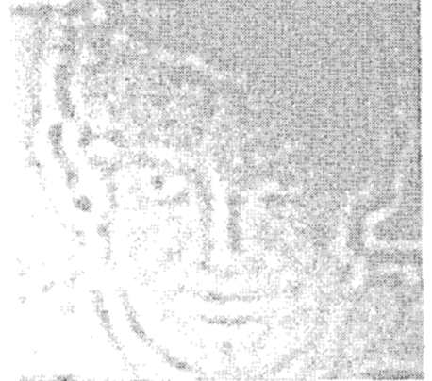
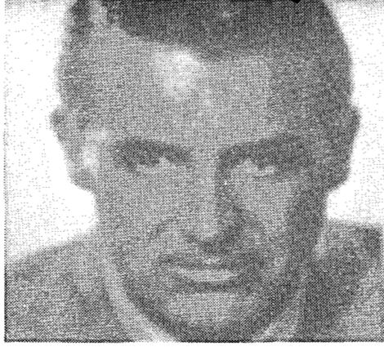
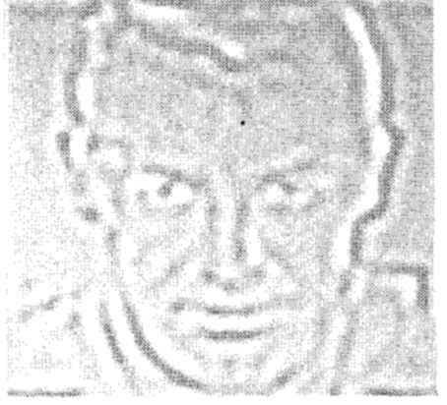
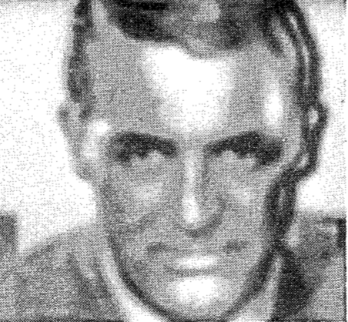
New definition: Local band-limited contrast
Bandpass amplitude image
Reconstructed image
Local band-limited contrast image
Reconstructed image

Slide 14
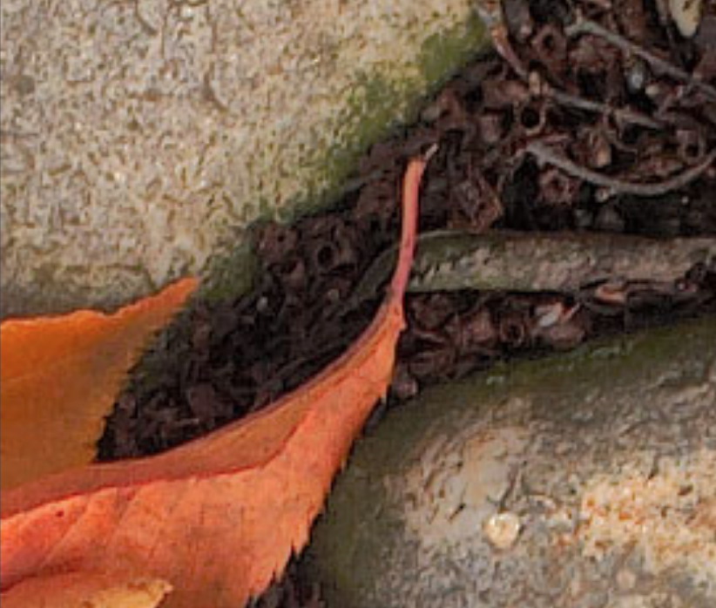
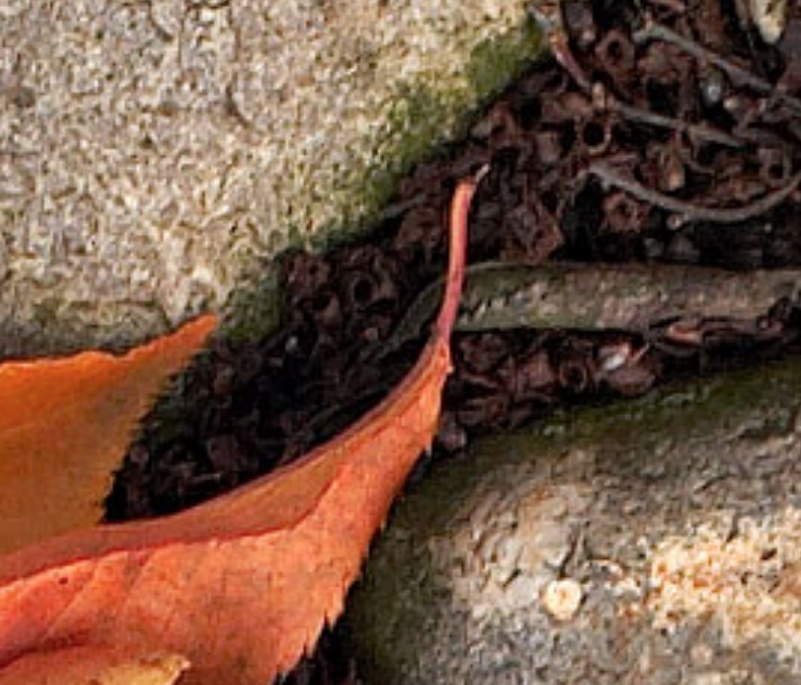
New definition: Local band-limited contrast
High contrast
original
Local band-limited contrast
example

Slide 15
Conclusion
Contrast in simple patterns
Contrast in images
New definition in contrast
Local contrast enhancement

Slide 16
Thanks!
Any questions?

Slide 17
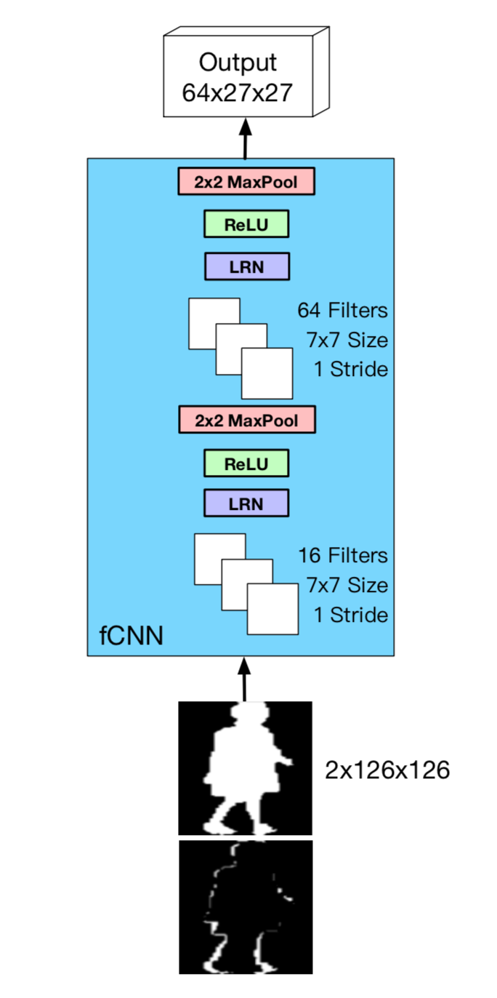
◈fCNN contains two convolutional layers. The first one includes 16 filters. The second one includes 64 filters.
◈All filters are of size 7×7 and applied with one stride.
◈Spatial pooling and local response normalization (LRN) are appended after each convolutional layer.
◈After applying the first convolutional layer and pooling layer, we obtain 16 feature maps sized 60 × 60, and 64 27 × 27 feature maps after the second convolutional and pooling layer.

Slide 18
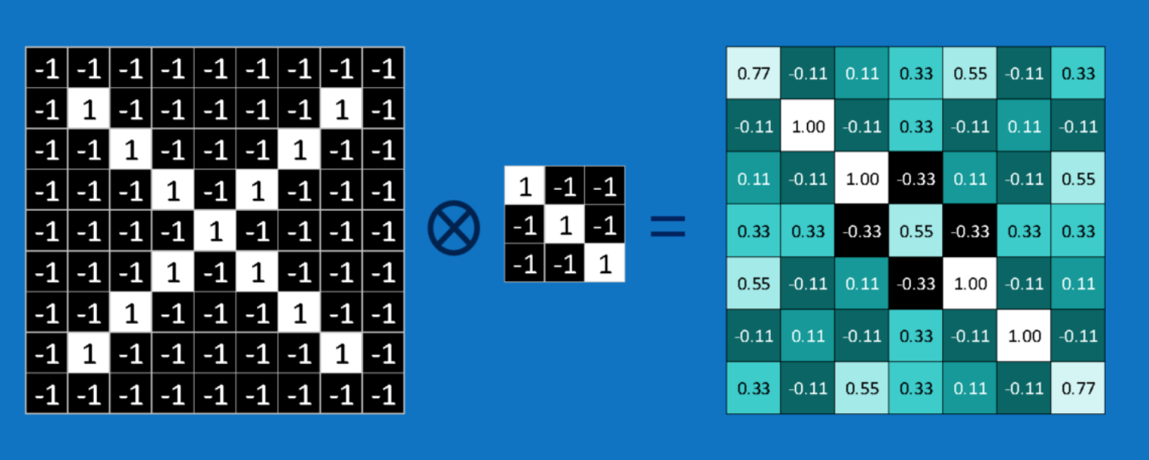
What is CNN?
Image * filter (feature filter) = feature maps
Each portion needs do convolution

Slide 19
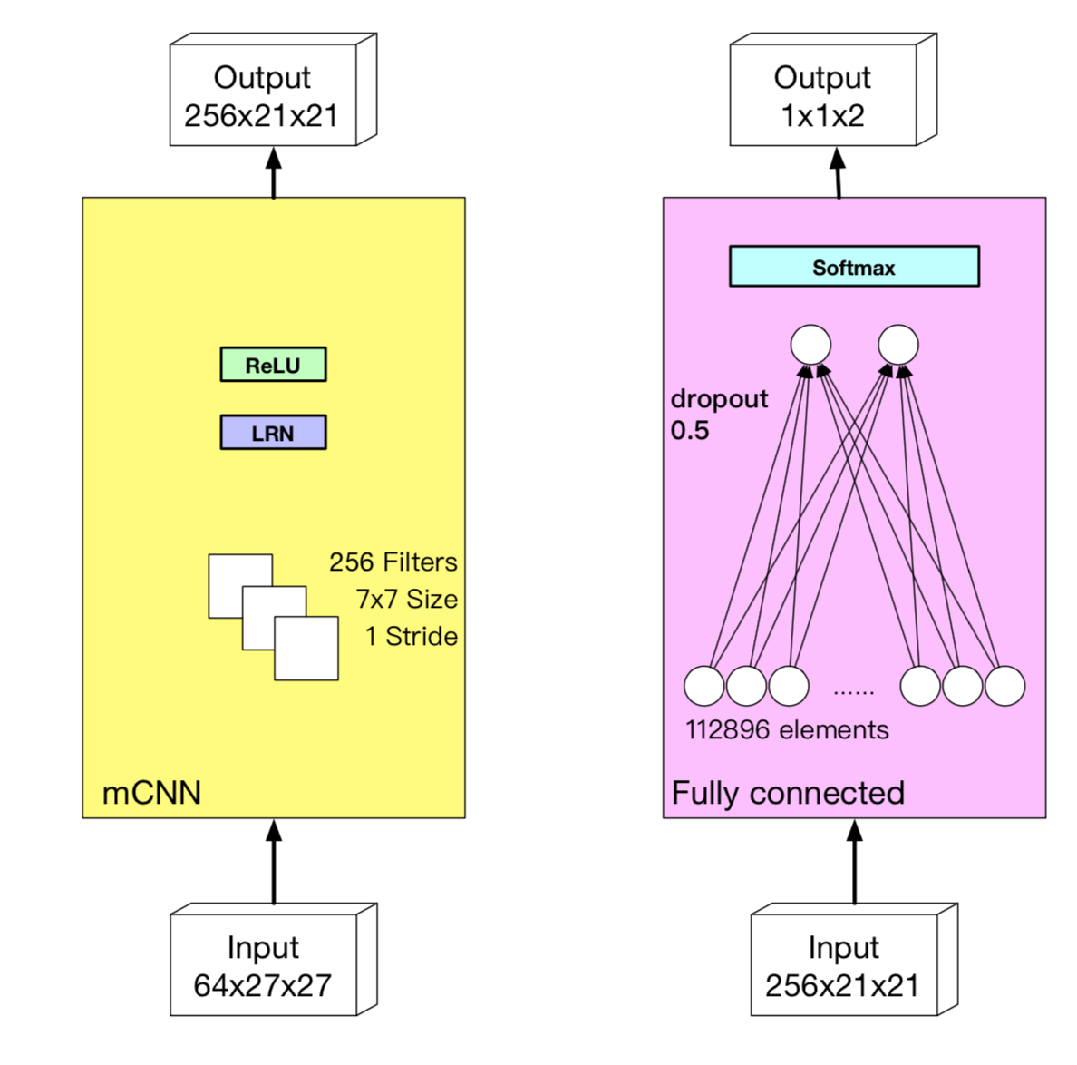
◈Then a mapping convolutional layer, i.e. mCNN, is applied to project the difference feature to a similarity vector.
◈The output size of mCNN is 256×21 ×21. Then it is reshaped to one dimension vector with 112896 elements.

Slide 20
Experiment
Demonstration of the proposed method on OU-ISIR large population dataset and significant results
Notes:
1. After a detailed and theoretic explanation about the method, I present how this method will be applied to datasets

Slide 21
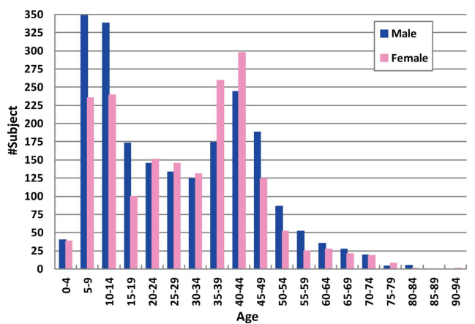
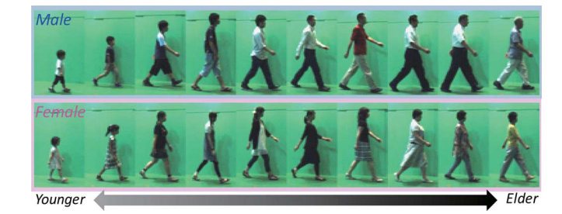
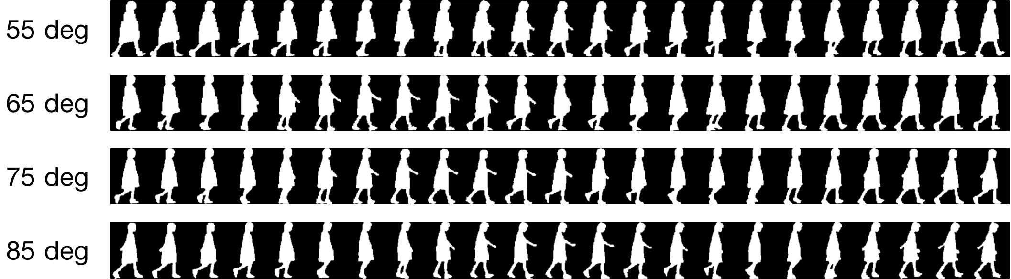
OU-ISIR Gait Database, Large Population Dataset
Notes:
The dataset covers a whole generation from 1 years old - 94 years old. Also is balanced in gender. Female to male ratio is 1. Most significantly all silhouette images are in high quality

Slide 22
Gallery and Probe
A subset with 1912 subjects of OULP-C1V1 is used as the evaluation set.
Each subject has probe and gallery gait sequences with different angle views: 55, 65, 75 and 85 degree.
Each subject has 8 sequence.
One sequence has a range from 19-43 frames.

Slide 23
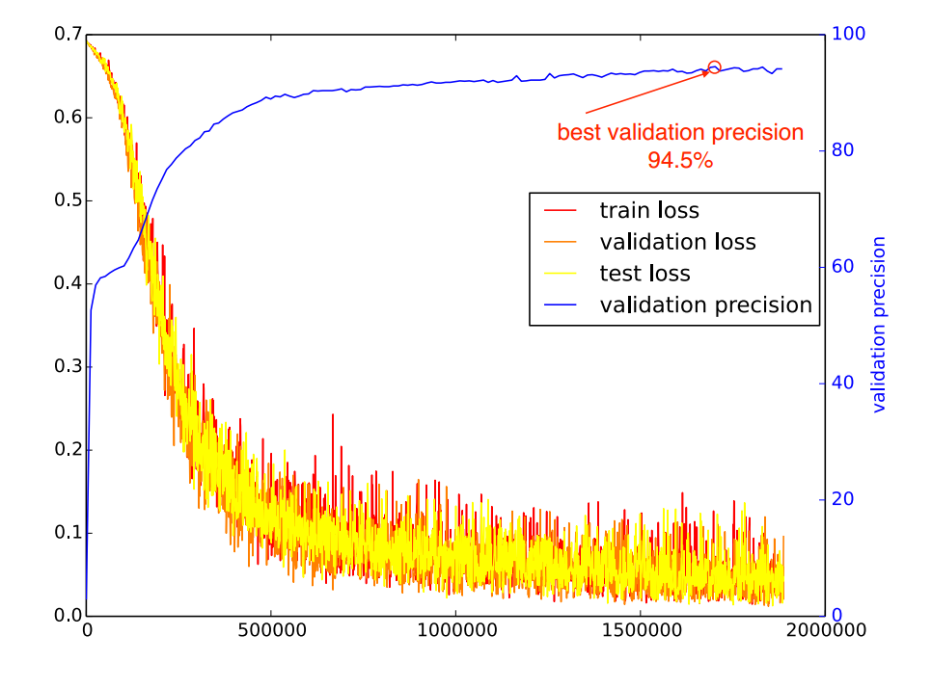
Training and Validation
Only one half of the data is used for training. The training set is split into 856 subjects for training and 100 for validation.
With every 100 iterations, validation test is performed. And by increasing the total iterations the validation precision increases significantly.
After comparison, the model with 1.8 million iterations and 94.5% precision is chosen for testing.
Notes:
After training with different total iterations, the model with 1.8 million iterations and 94.5% precision is chosen for testing

Slide 24
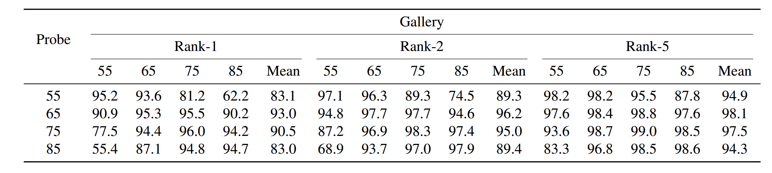
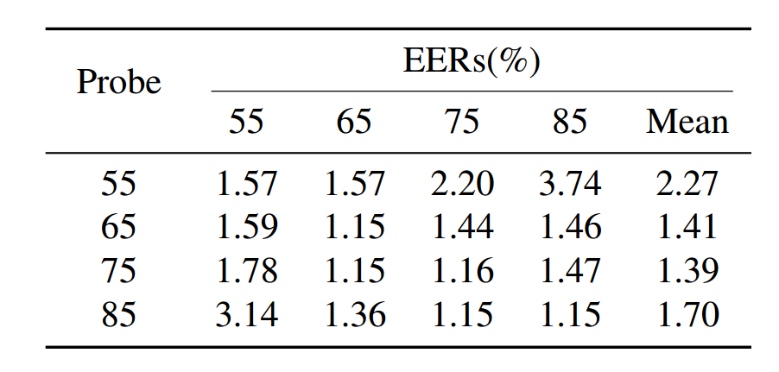
Result

Slide 25
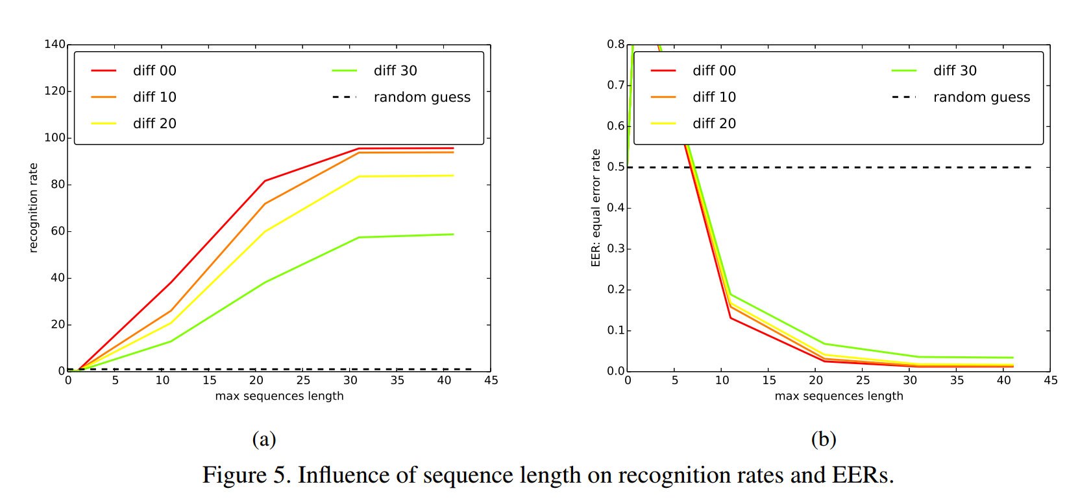
Sequence length

Slide 26
Comparison with other methods
LDA
Linear Discriminant Analysis
DATER
MvDA
Multi-view discriminant analysis
Transfer learning across two gait databases
Provided the rigorous sensitivity analysis
GMLDA
Generalized Multiview Analysis
Multi-view feature extraction
Extending several techniques to their multiview counterpart.
CCA
Averaged Silhouette

Slide 27
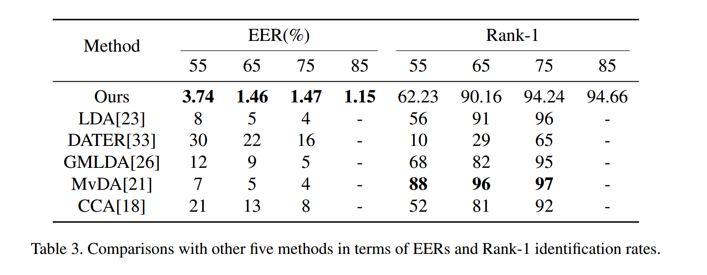
Comparison with other methods
Notes:
View angle

Slide 28
Conclusion
CNN based
Silhouette sequence
Cross view
Better Verification Accuracy

Slide 29
Thanks!
Any questions?

Slide 30
What is CNN?
Image * filter (feature filter) = feature maps
Each portion needs do convolution

Slide 31
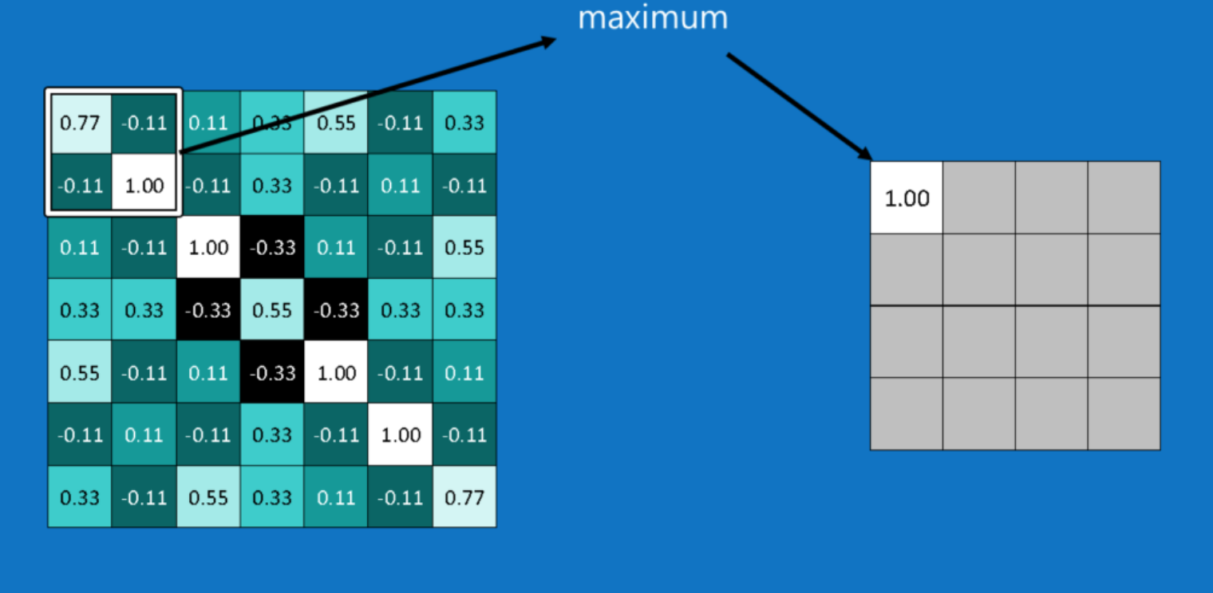
What is CNN?
Max pooling
Max pooling is for downsampling.
Max pooling avoids some edge and redundant information.

Slide 32
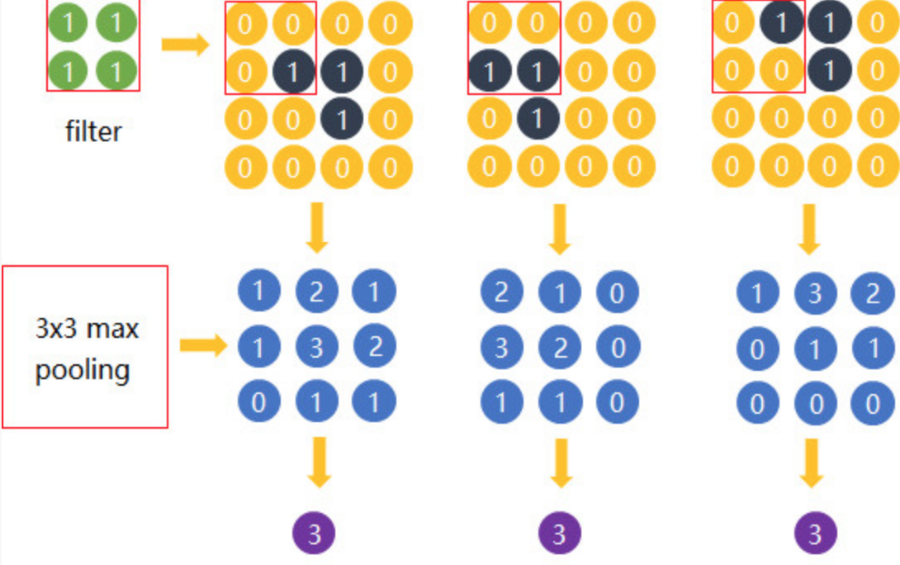
What is CNN?
Max pooling
The most useful information is in the position ( value is 3 which is max value).

Slide 33
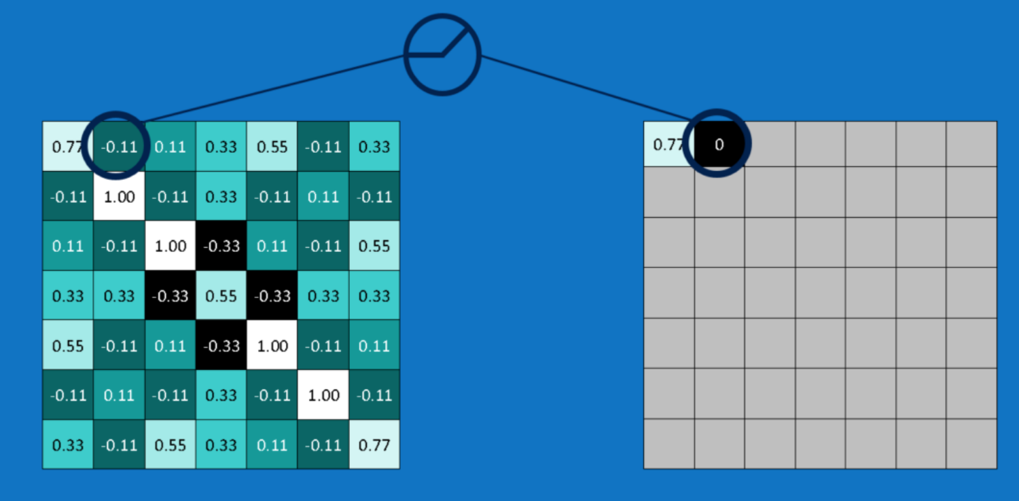
What is CNN?
ReLUs (rectified linear units)
Change the negative value to zero
Keep the math from breaking

Slide 34
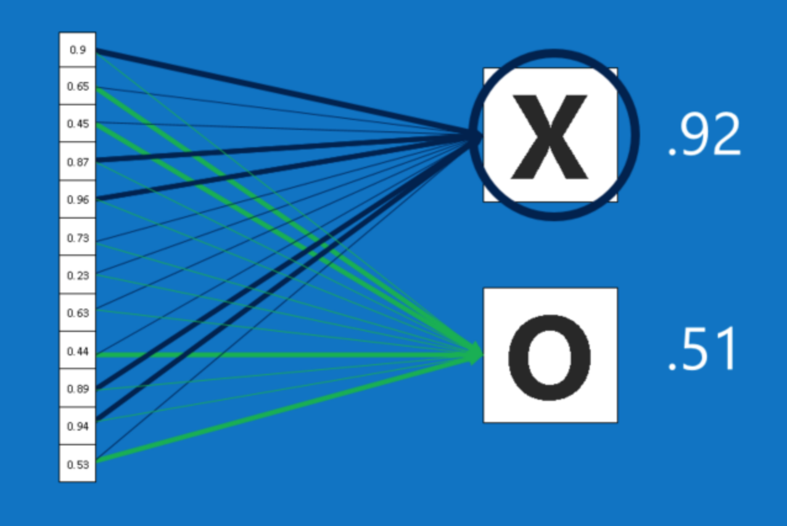
What is CNN?

